Slide 1
VCCS Diversity Climate Survey

Slide 2
What is the diversity climate survey?
A moment in time
What is your experience working at or attending our colleges?
Questions built around diversity, broadly defined.
Safe and respectful environment

Slide 3
Who is the survey designed to reach? Everyone!
Two Surveys
Rare Opportunity
Employees
Students
20 minutes
Broad diversity definition
Hearing from employees and students who may feel like they live in the margins.

Slide 4
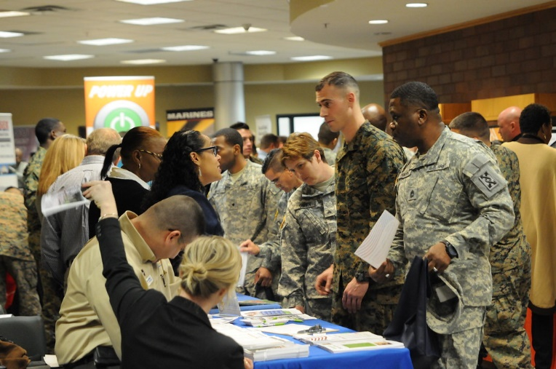
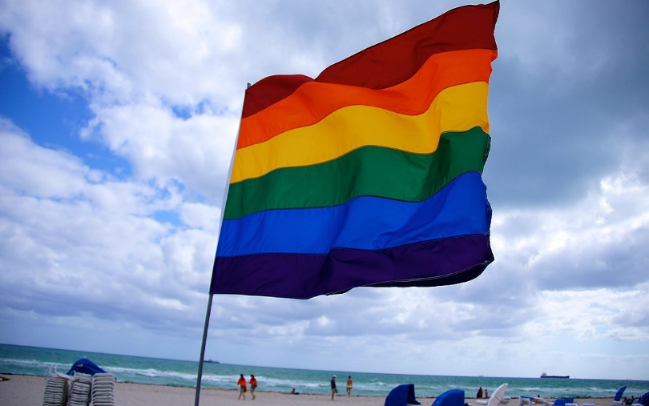
What is diversity, broadly defined?
Notes:
Pictures show different categories of people: Veterans, LGBTQIA+, Disabilities, People of Color, Religion

Slide 5
Diversity Climate Assessment at 22 colleges
Funded by the Lumina Foundation
Customized to fit Virginia’s Community Colleges
Can provide a comparative, national view.
NVCC conducted same surveys in early Fall.

Slide 6
Fear not: Don’t fear sharing; Don’t fear what you hear
“Doing nothing sends a terrible message versus getting out in front of potential issues, finding out what they are, and addressing them. Things will only get worse until they blow up on you and you have tremendous problems. Students and employees will leave and the financial and reputation costs can be immeasurable.”
Lenore Pearlstein, President
Campus Climate Surveys

Slide 7
When is the survey distributed?
April 4 through April 20
During Summer: Teams to review student, employee data
Fall share recommendations for moving forward
Notes:
We’re behind schedule.

Slide 8
Special thanks…
This initiative is being supported in part by the Virginia Foundation for Community College Education and the Anthem Blue Cross/Blue Shield Foundation.
Their generous support means we will have a drawing for at least two $25 gift cards - one for a student, one for an employee – at 22 of Virginia’s Community Colleges involved in the survey.

Slide 9
Type of Student
Category Count | First-generation | Transfer | Pell-grant recipient | Adult student | Dual-enrollment
Students | 117 | 52 | 65 | 194 | 53

Slide 10
Enrollment Status
Category Count | Part-time | Full-time (over 12 hours) | Continuing education/Fast Forward
Students | 116 | 168 | 11
Notes:
High percentage of full-time respondents

Slide 11
Demographics
Category Count | Veterans | Disabled | LGBTQIA+ | People of Color
Students | 21 | 48 | 49 | 95
Employees | 14 | 14 | 13 | 22
Notes:
Higher percentage of student respondents were people of color

Slide 12
Services for Special Communities
Totals (n) | Veterans | Disabled | LGBTQIA+ | People of Color
Students | 21 | 48 (22 serv.) | 57 | 96
Employees | 14 | 16 (2 serv.) | 13 | 22
Notes:
“How satisfied are you with the following items related to our institution's services for veterans?”
Veterans most satisfied with services
Employee People of Color most dissatisfied with services

Slide 13
Open Expression
Totals (n) | Religion | Politics | LGBTQIA+ (Sexual Id.)
Students | 286 | 281 | 56
Employees | 123 | 123 | 13
Notes:
“I can openly express my religious/spiritual beliefs on campus.”
Measures of agreement with affirmative statements of open expression
Higher scores (worse) than satisfaction with services
Worst scores in Political expression
Employees feel less freedom than students.

Slide 14
Welcomeness/Respect
Totals (n) | Veterans | Disabled | Religion | Politics | LGBTQIA+ | People of Color
Students | 20 | 48 | 286 | 281 | 56 | 94
Employees | 14 | 16 | 123 | 122 | 13 | 22
Notes:
“As a veteran, I feel welcome on campus.”
“My religious/spiritual beliefs are treated with respect by administrators.”
Best scores for people of color
Worst scores in respect for political views
Employees feel less welcome than students.

Slide 15
Experience with Discrimination/Bias/Harassment
Category Count | Bullying | Discr. on Polit. | Discr. on Age | Discr. on Race | Retaliation
Students | 11 | 11 | 6 | 3 | 0
Employees | 26 | 16 | 23 | 18 | 14
Notes:
“Have you experienced any of the following while at our institution? Check all that apply.”
Total Respondents Students: 238 Employees: 108
Most experience with bullying
Much higher experience with negative events for employees

Slide 16
Why Discrimination/Negative Event Wasn’t Reported
Category Count | I decid. it wasn’t import. enough. | I didn’t feel/thing anyth. would happen. | I feared retaliation.
Students | 17 | 13 | 6
Employees | 8 | 17 | 20
Notes:
Students generally not reporting because they don’t think event was important enough
Employees generally not reporting because they fear retaliation
Total Respondents
Students: 26 Employees: 34

